Slide 1
Sensitivity study of individual cost components in MMF
Juli Mueller
julianemueller@lbl.gov
LBNL

Slide 2
Based on Ray’s Uncertainty Propagation Code
Changed code such that we can consider uncertainty in individual cost components (22 cost components)
We select one component at a time and allow for uncertainty and fix all other components to deterministic values (mean in spreadsheet)
For each component, we run the multi-objective optimization 100 times (100 different random seeds to randomly select a value for the uncertain cost component)
We do this for K values {-2, -1, 1, 2, 3, 4}
22 components * 100 runs * 6 K values = 13,200 optimization runs
Code runs the individual multi-objective optimizations in parallel (~20-25mins for 100 optimizations [8 at a time], each MOGA run uses 100 generations and 100 individuals)

Slide 3
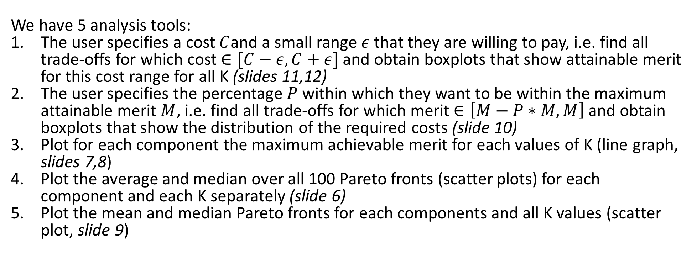
Besides the automatic optimizer, we need an analysis tool that lets us study the results efficiently
We have 5 analysis tools:
The user specifies a cost $C$and a small range $ε$that they are willing to pay, i.e. find all trade-offs for which cost $∈[C−ε, C+ε]$ and obtain boxplots that show attainable merit for this cost range for all K (slides 11,12)
The user specifies the percentage $P$ within which they want to be within the maximum attainable merit $M$, i.e. find all trade-offs for which merit $∈\left[M−P∗M, M\right]$ and obtain boxplots that show the distribution of the required costs (slide 10)
Plot for each component the maximum achievable merit for each values of K (line graph, slides 7,8)
Plot the average and median over all 100 Pareto fronts (scatter plots) for each component and each K separately (slide 6)
Plot the mean and median Pareto fronts for each components and all K values (scatter plot, slide 9)
We show the output of the analysis mostly for one cost component only (107-39-1, Diisobutylene).
The graphs will look different for different cost components)

Slide 4
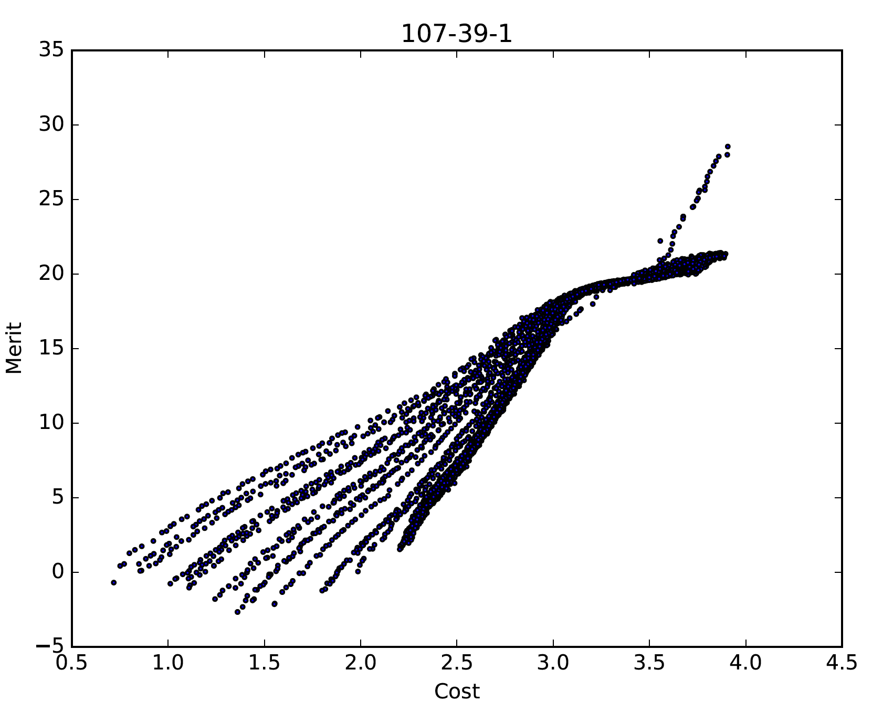
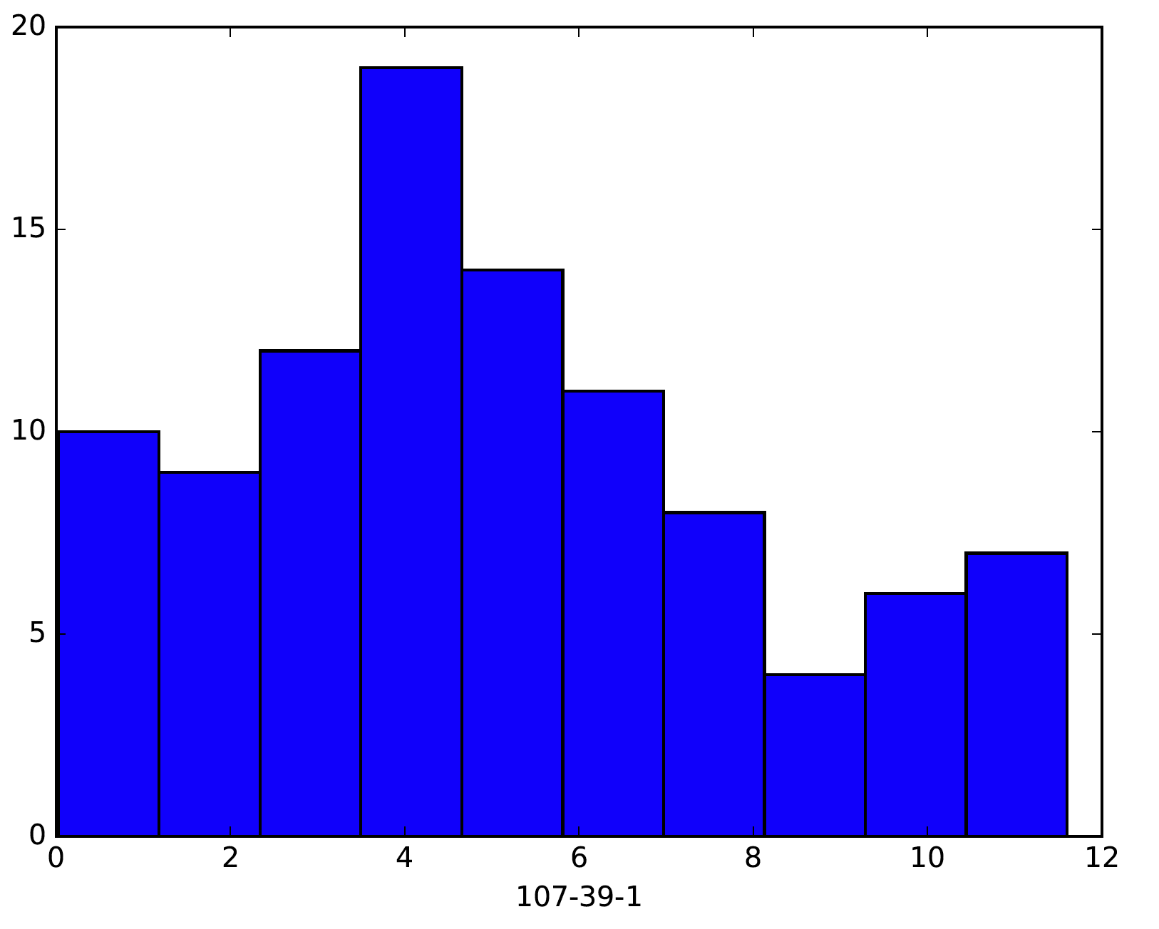
Each multi-objective optimization gives us as result a Pareto (trade-off) front
Cost distribution of 100 samples for component 107-39-1,
Diisobutylene, mean = 4, var = 4
Corresponding 100 Pareto fronts of bi-objective optimizations for K =2

Slide 5
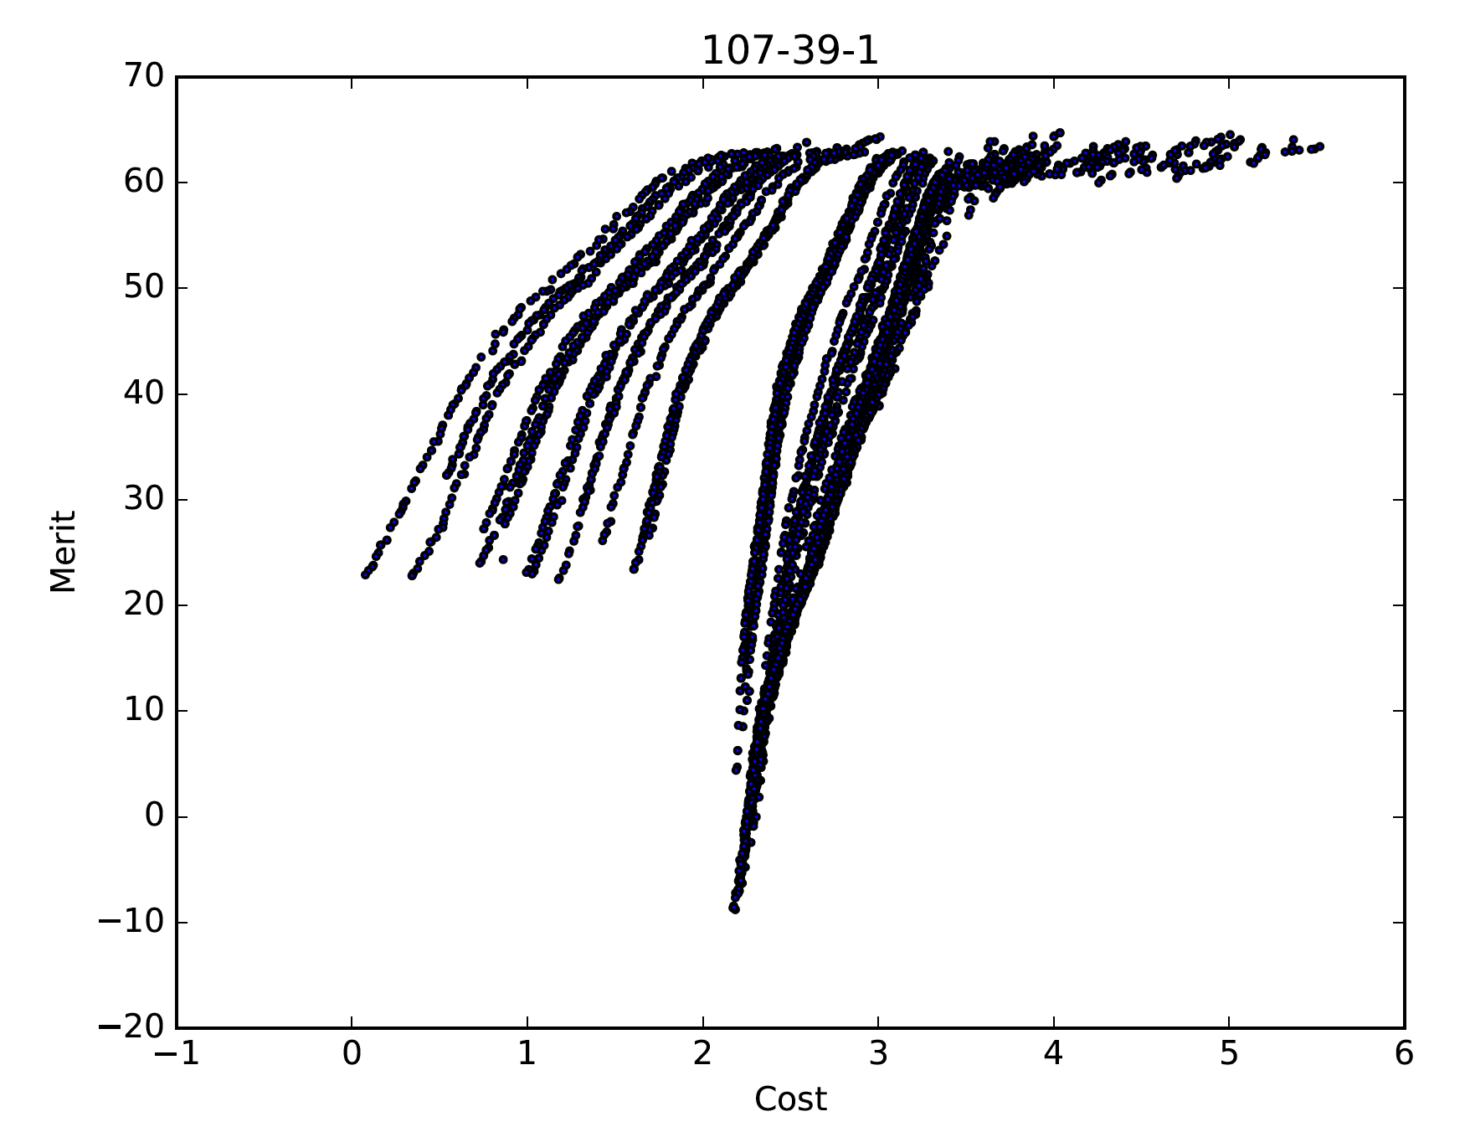
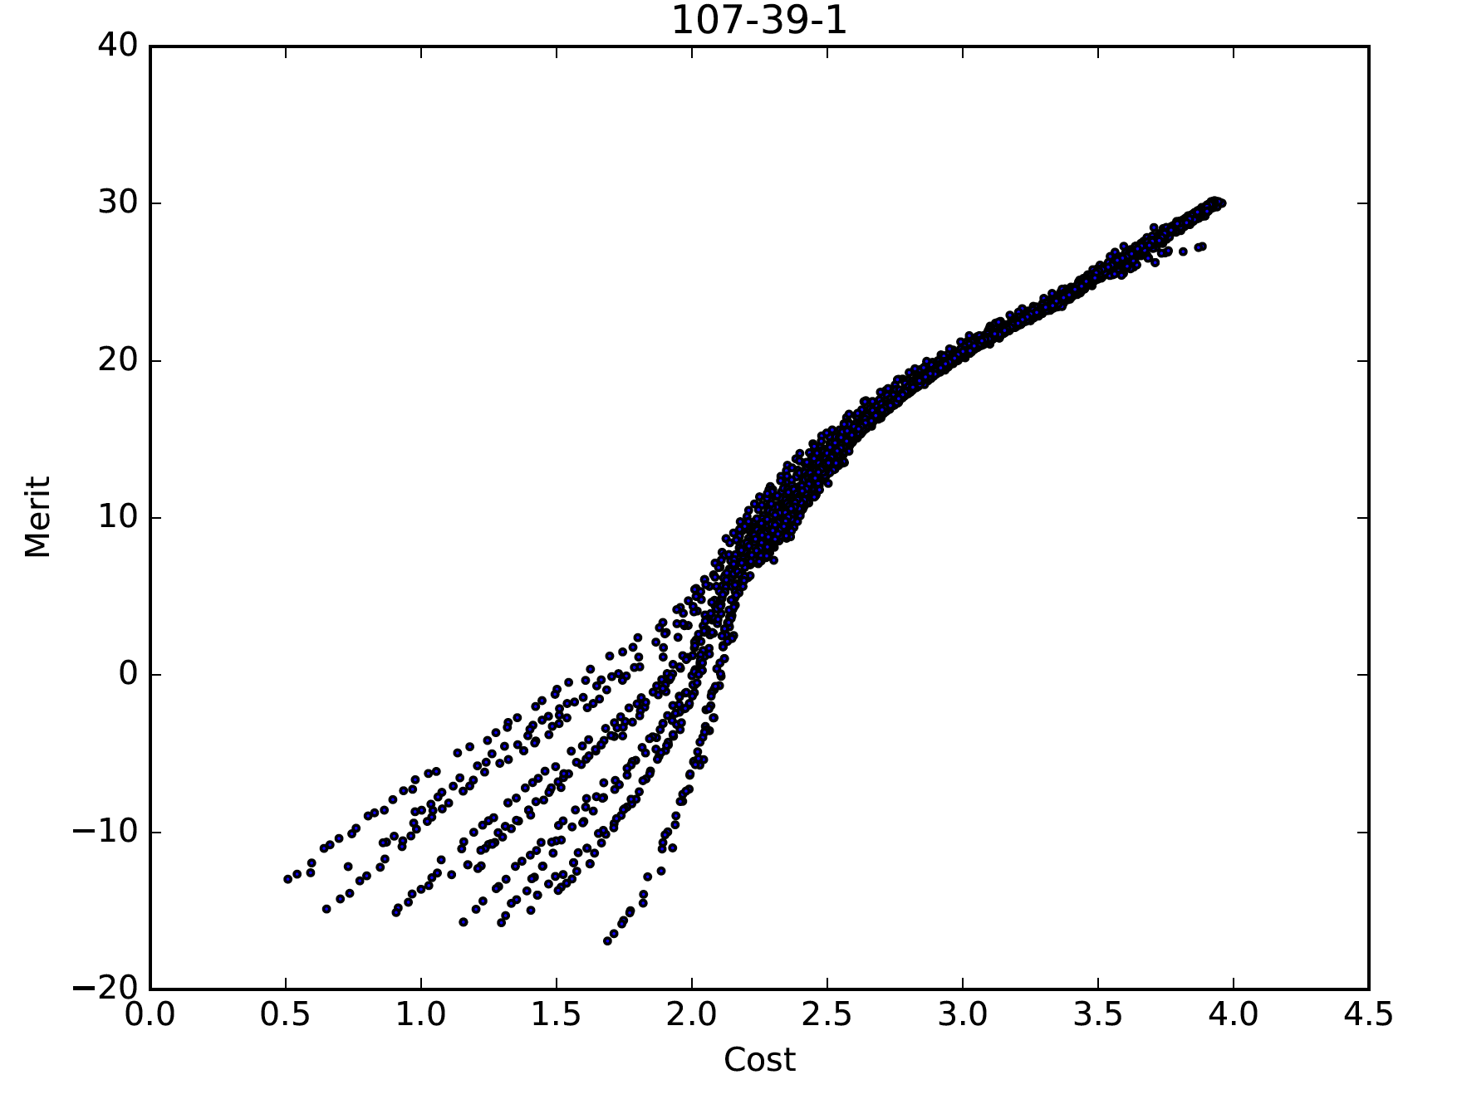
Pareto fronts for component 107-39-1, Diisobutylene, K = -2 (left), K = 4 (right)
Note the differences on axes!

Slide 6
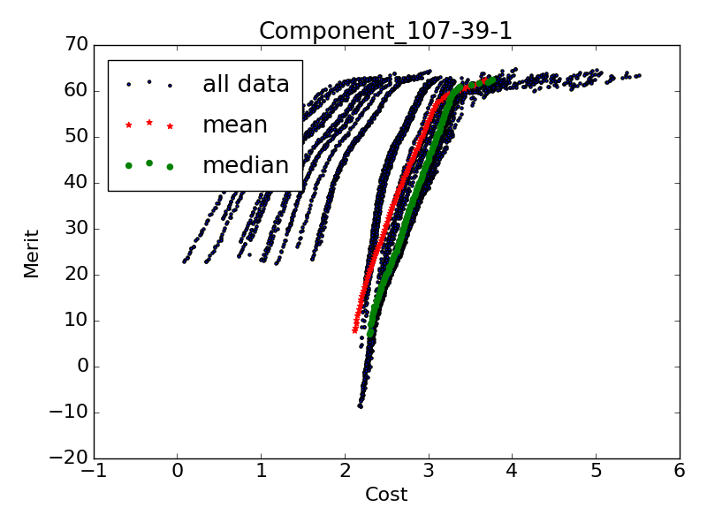
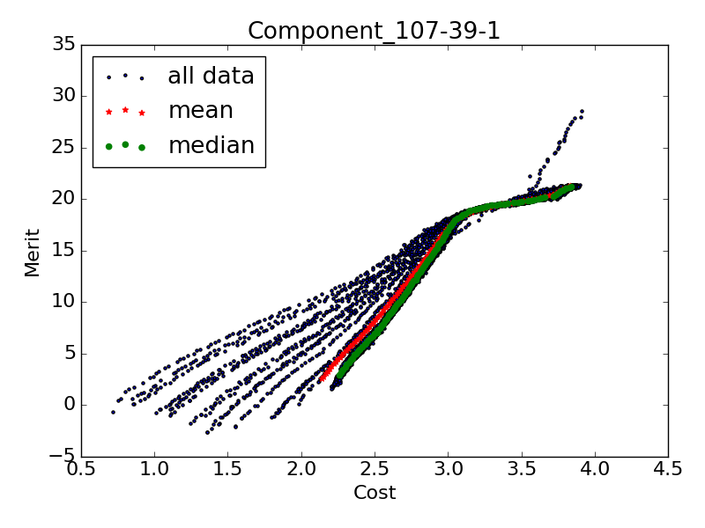
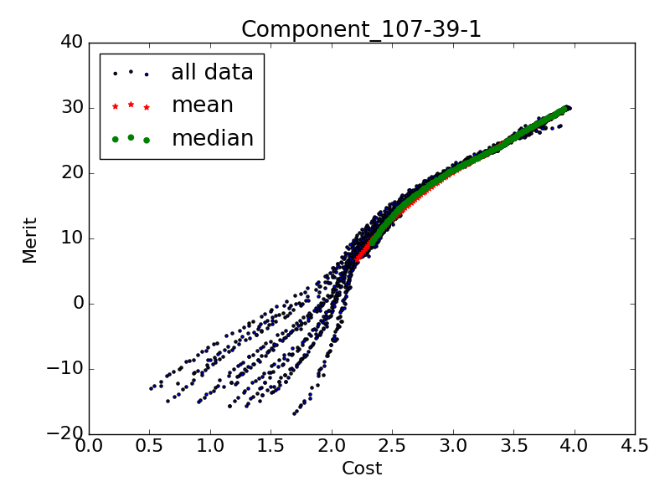
Mean and median Pareto fronts for component 107-39-1, Diisobutylene, K = -2 (left), K=2 (middle), K = 4 (right)
Note the differences on axes!
We obtain Pareto fronts of different shapes depending on if K<0 or K>0:
Pareto fronts for positive K values look more similar to each other;
Pareto fronts for negative K values look more similar to each other.
Attainable merit for given cost (bang for my buck) differs significantly depending on K.

Slide 7
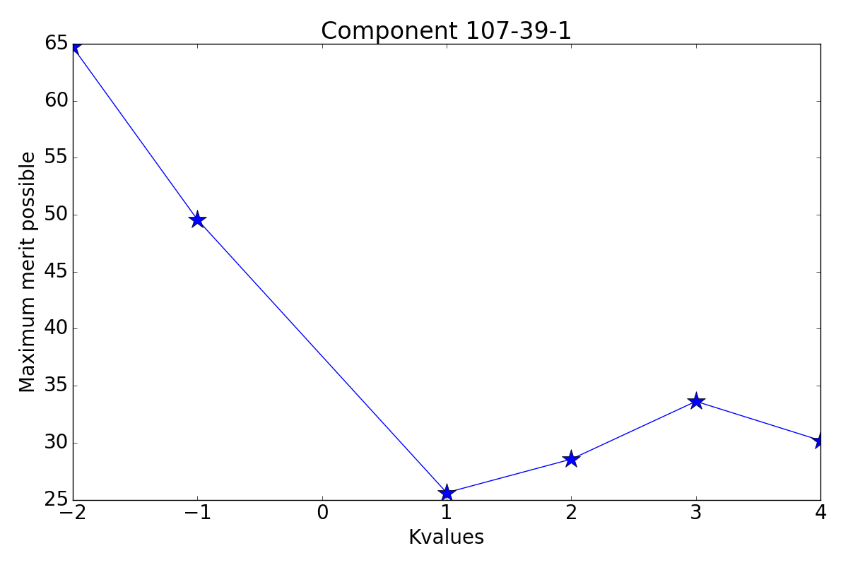
Maximum attainable merit for each K value for component 107-39-1, Diisobutylene
Graph may look different for other components (see next slide)!
Does it make sense that negative K-vales have higher merit?
Does it make sense that merit for K=4 is smaller than merit for K=3 and K=2?

Slide 8
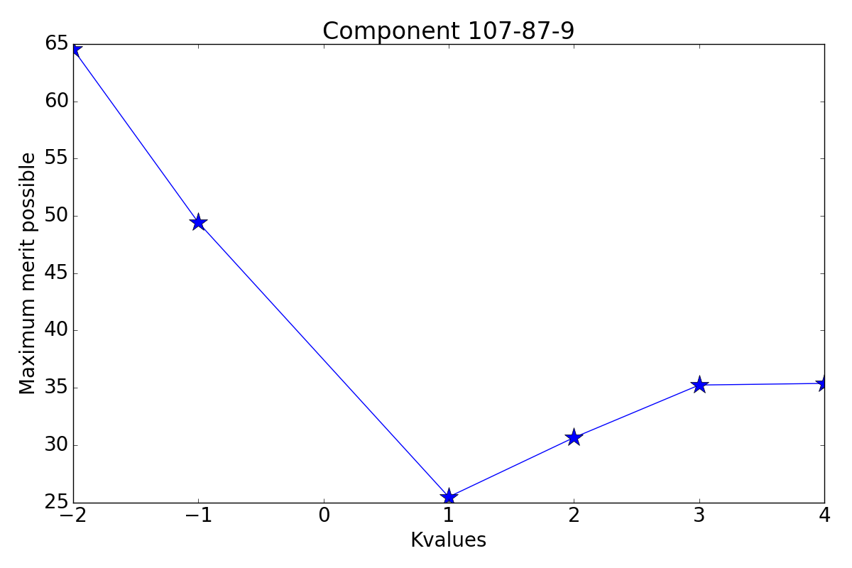
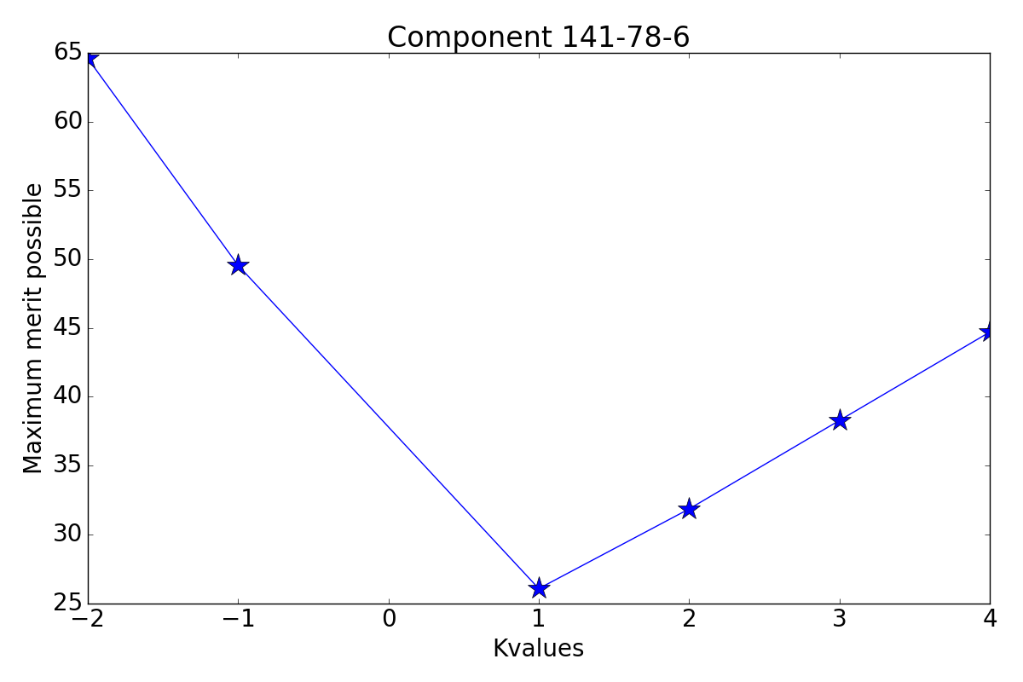
Maximum attainable merit for two other components
Do the differences in the graphs’ shapes make sense?
2-pentanone, mean = 4, var = 1
Ethyl acetate, mean = 4, var = 4

Slide 9
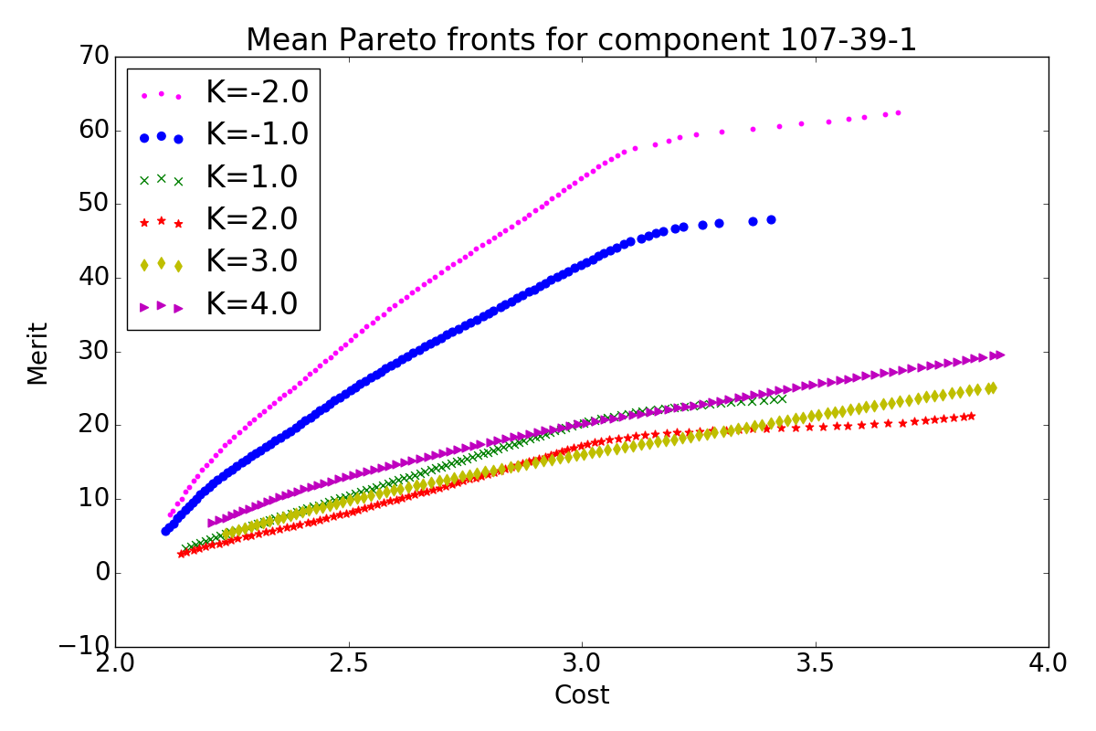
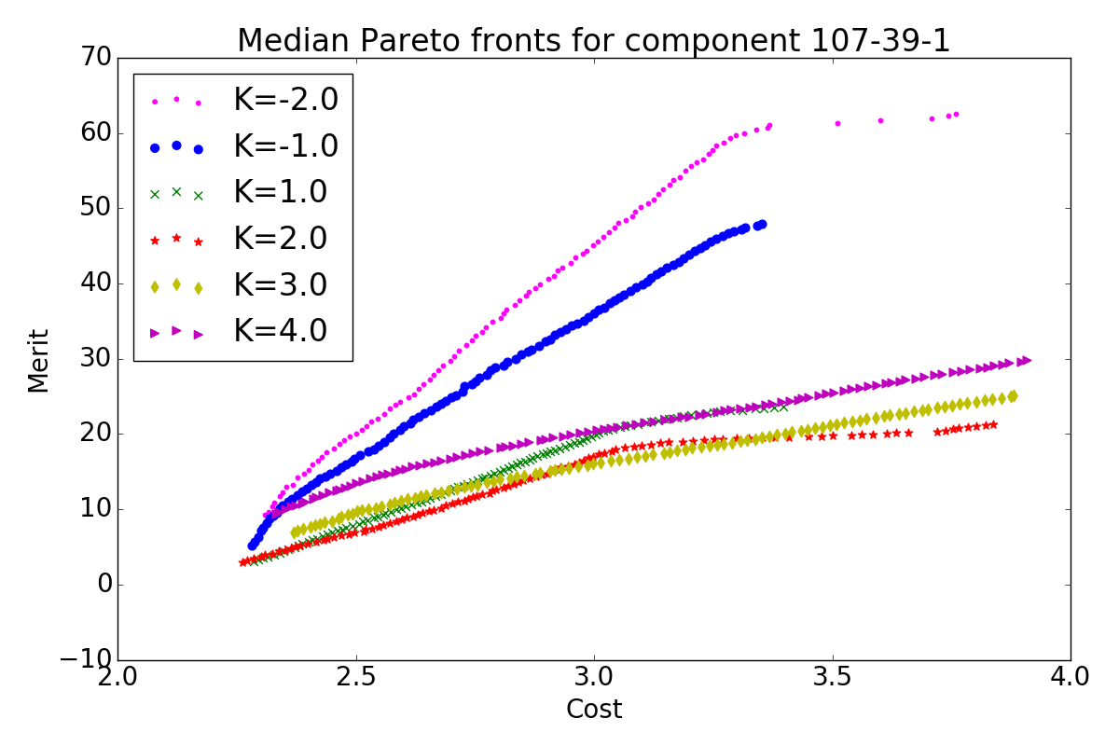
Mean and median Pareto Fronts for component 107-39-1, Diisobutylene, for all K values
Mean: This is what we can expect as trade-off curves when allowing uncertainty in component 107-39-1; Mean is sensitive to outliers
Median: 50% of the Pareto fronts are “left of the median Pareto front” and 50% are ”on the right”
Median is not sensitive to outliers

Slide 10
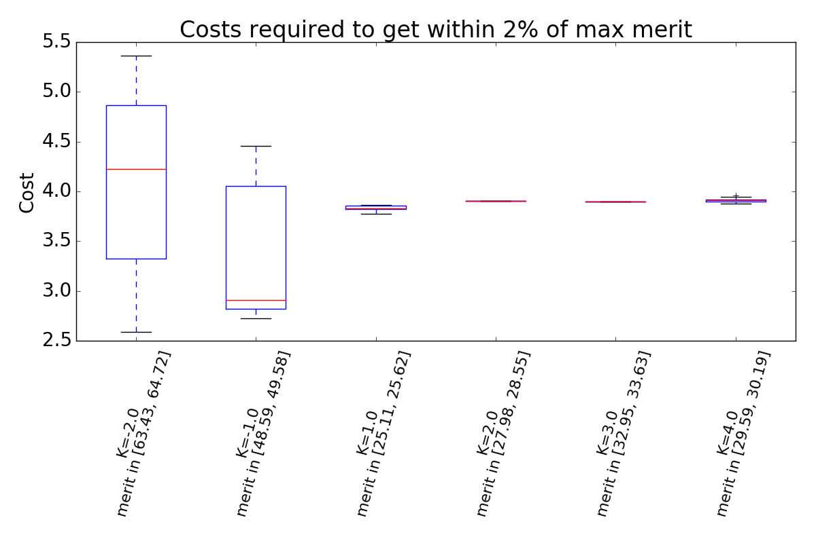
Boxplots show the distribution of costs required to get within 2% of maximum possible merit value
Component 107-39-1 Diisobutylene
Below the boxplots, we note the range of values that are within 2% of maximum achievable merit
For K>0: the costs to get with 2% of maximum possible merit are approximately equal for all K>0
For K>0: The 2%-max-merit-ranges are similar to each other
For K<0: the costs associated with getting within 2% of max merit differ greatly
For K<0: the 2%-max-merit-ranges differ significantly
For other components, these boxplots look different

Slide 11
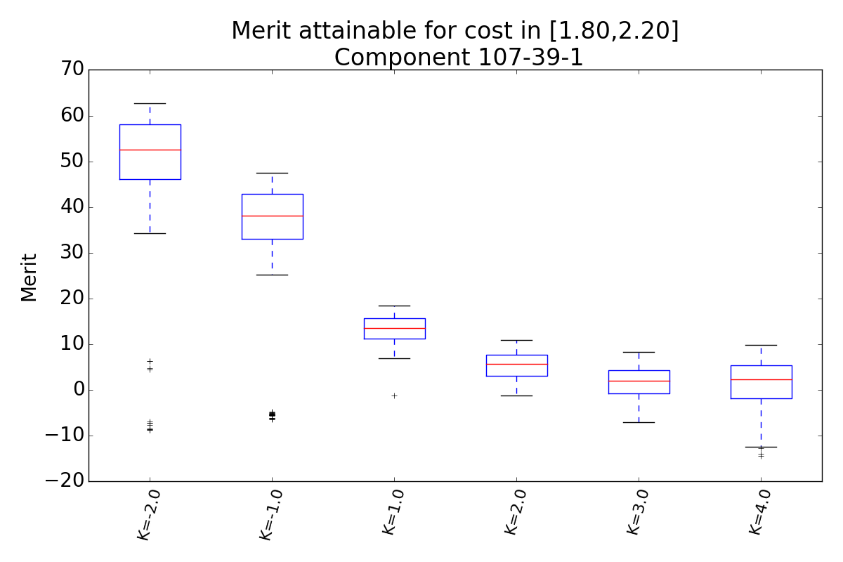
Boxplots show the distribution of merit I can obtain if I am willing to pay between 1.8 and 2.2 cost units
Component 107-39-1 Diisobutylene
The plot shows the merit we can obtain for different K values if we are willing to pay between 1.8 and 2.2 cost units
For this component: The achievable merit decreases as K increases, but appears to level off (this is different for different cost intervals and components)

Slide 12
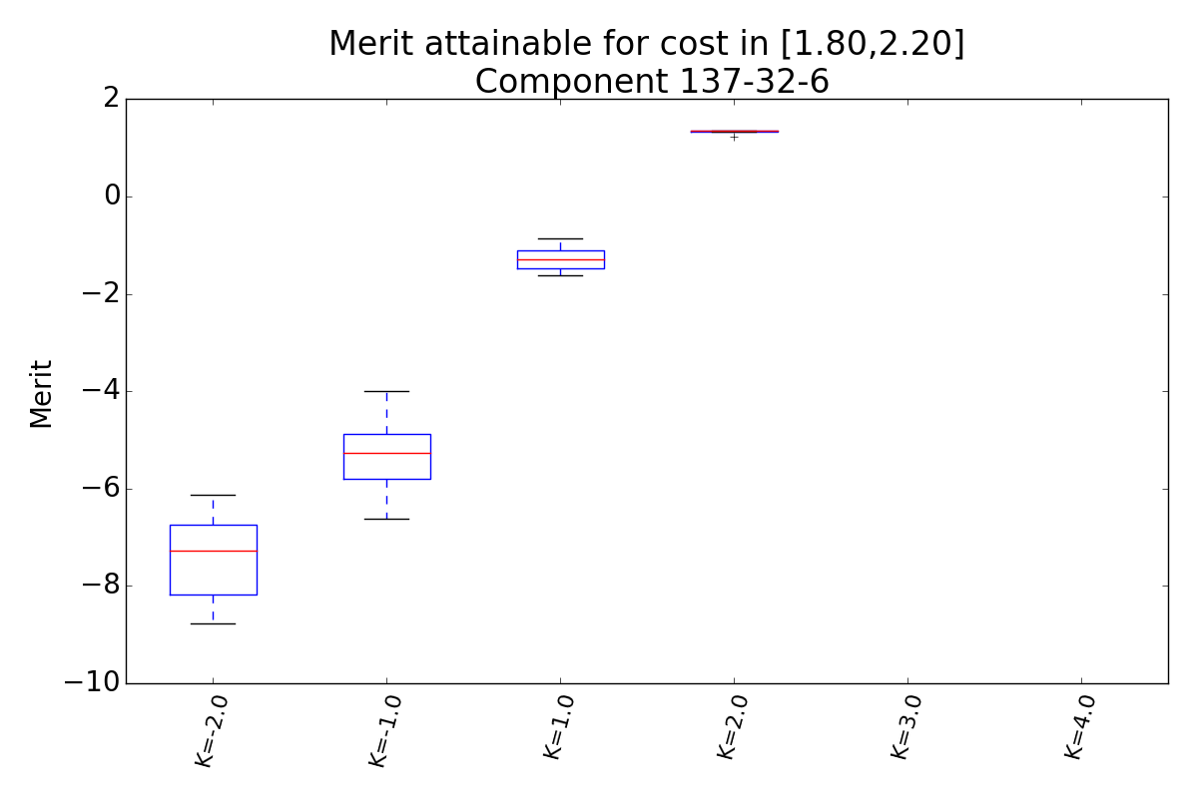
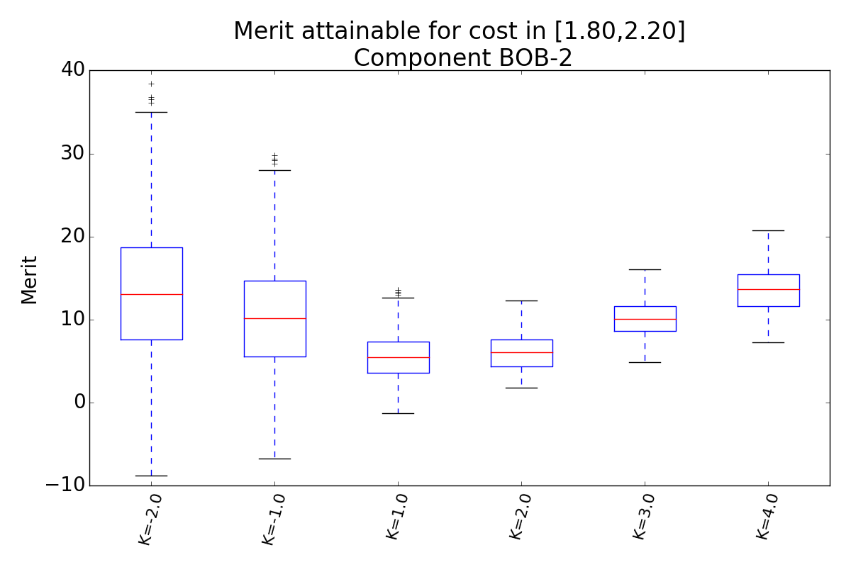
Boxplots show the distribution of merit I can obtain if I am willing to pay between 1.8 and 2.2 cost units
The merit attainable for a cost within [1.8, 2.2] increases with K value for component 137-32-6, 2-Me-1-butanol
No data for K=3 and K=4 because we need cost > 2.2 to get any solution
The merit attainable for a cost within [1.8, 2.2] increases with K value for component BOB-2

Slide 13
Sensitivity study of all cost components in MMF
We allow uncertainty in all cost components simultaneously
22 components
100 optimization runs, for each run we randomly draw a cost value for each component
We do this for K values {-2, -1, 1, 2, 3, 4}
100 runs x 6 K-values = 600 optimization runs
Same code specs as for single component analysis
Same analyses as described on slide 3

Slide 14
Plot the Pareto fronts for different K values
K = -2
K = -1
K = 1
K = 2
K = 3
K = 4

Slide 15
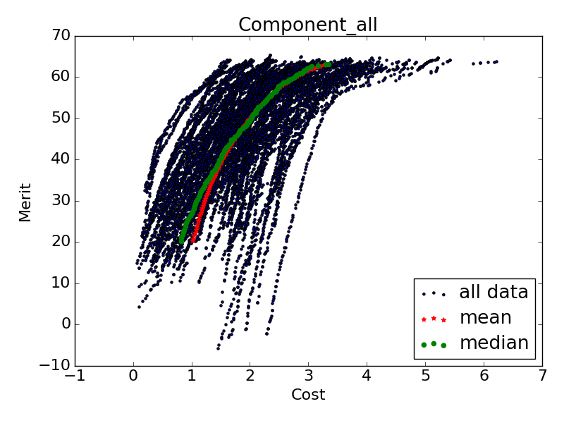
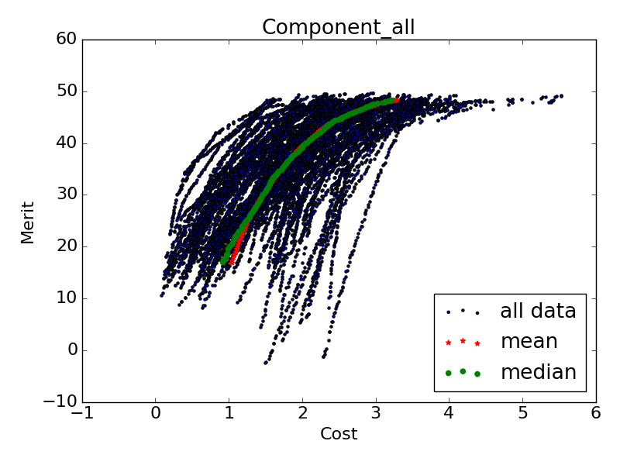
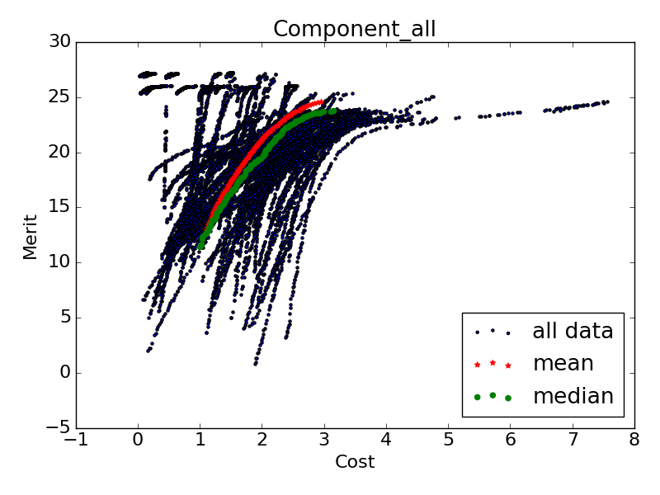
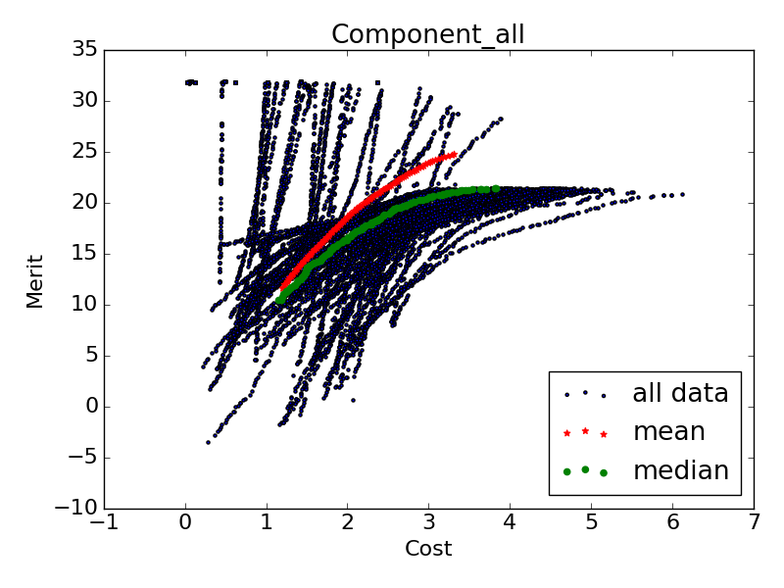
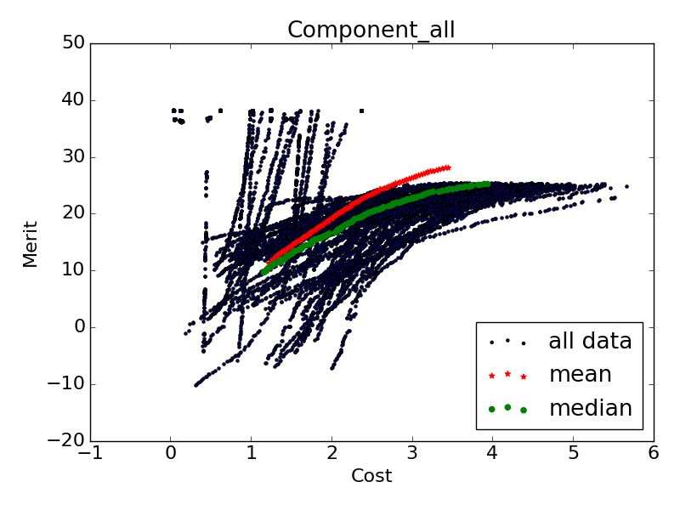
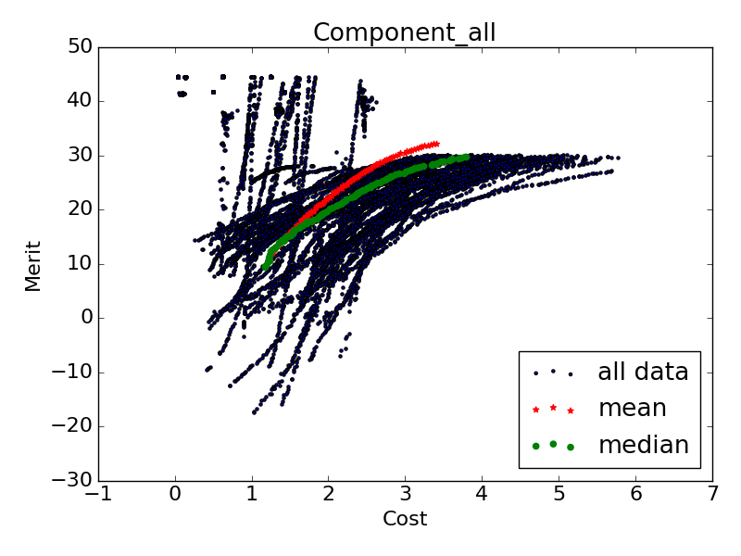
Mean and median Pareto fronts for different K values
K = -2
K = -1
K = 1
K = 2
K = 3
K = 4

Slide 16
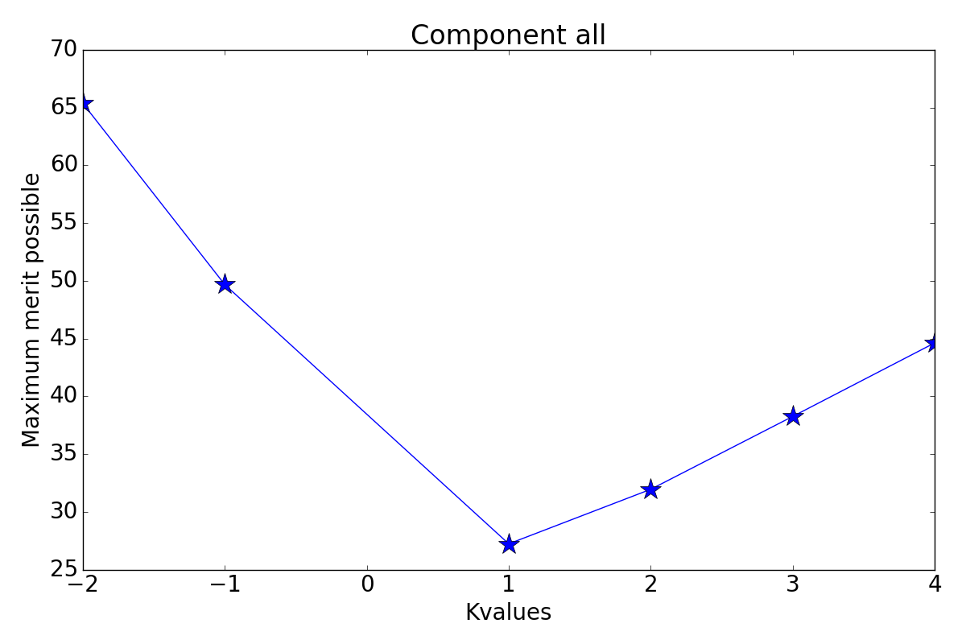
Maximum attainable merit for each K value

Slide 17
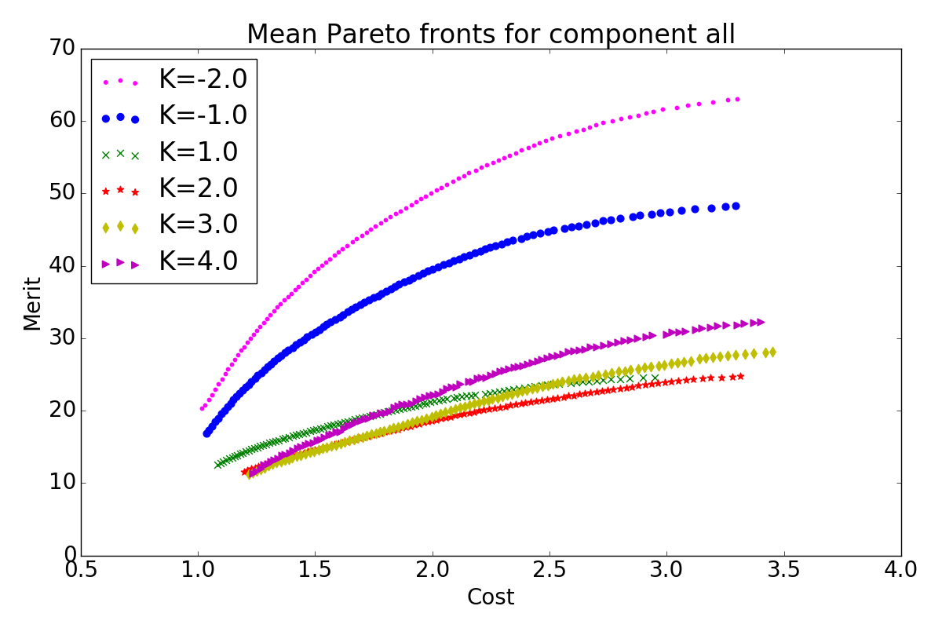
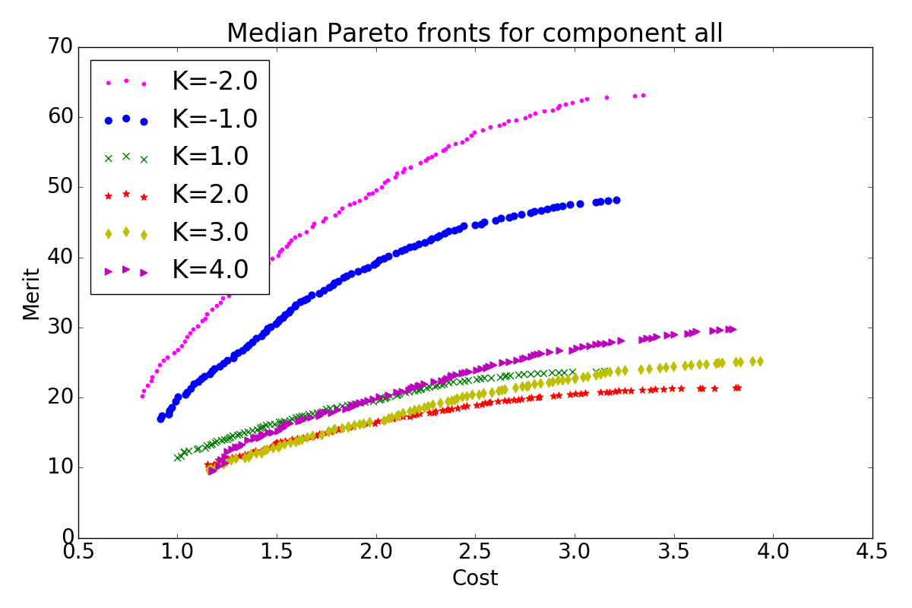
Mean and median Pareto fronts
Mean: This is what we can expect as trade-off curves when allowing uncertainty in component 107-39-1; Mean is sensitive to outliers
Median: 50% of the Pareto fronts are “left of the median Pareto front” and 50% are ”on the right”
Median is not sensitive to outliers

Slide 18
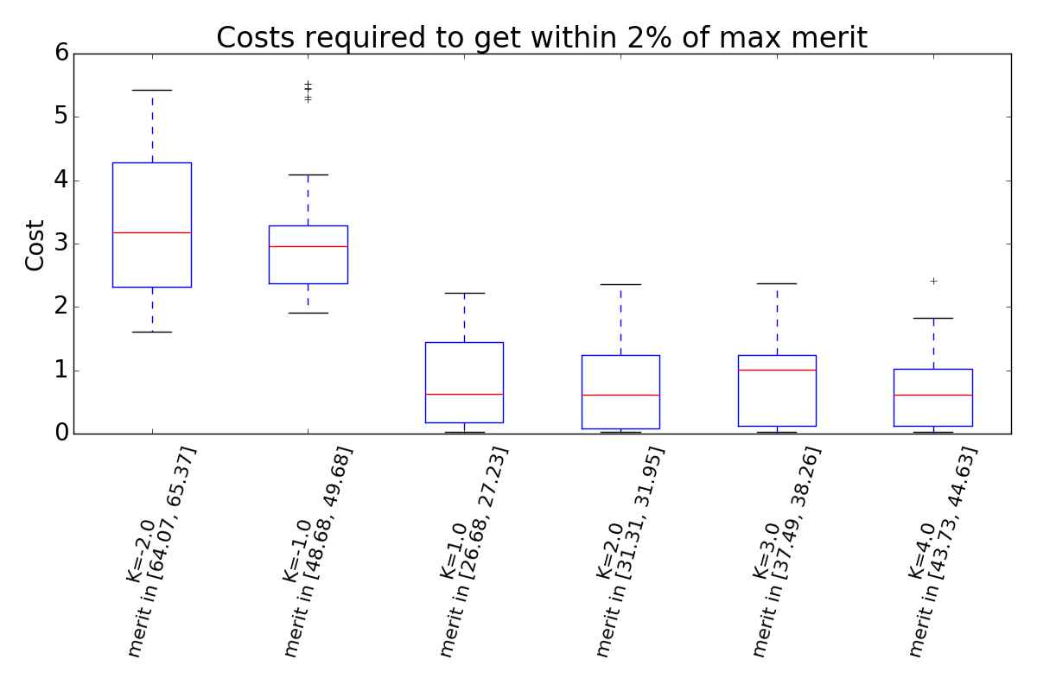
Boxplots show the distribution of costs required to get within 2% of maximum possible merit value

Slide 19
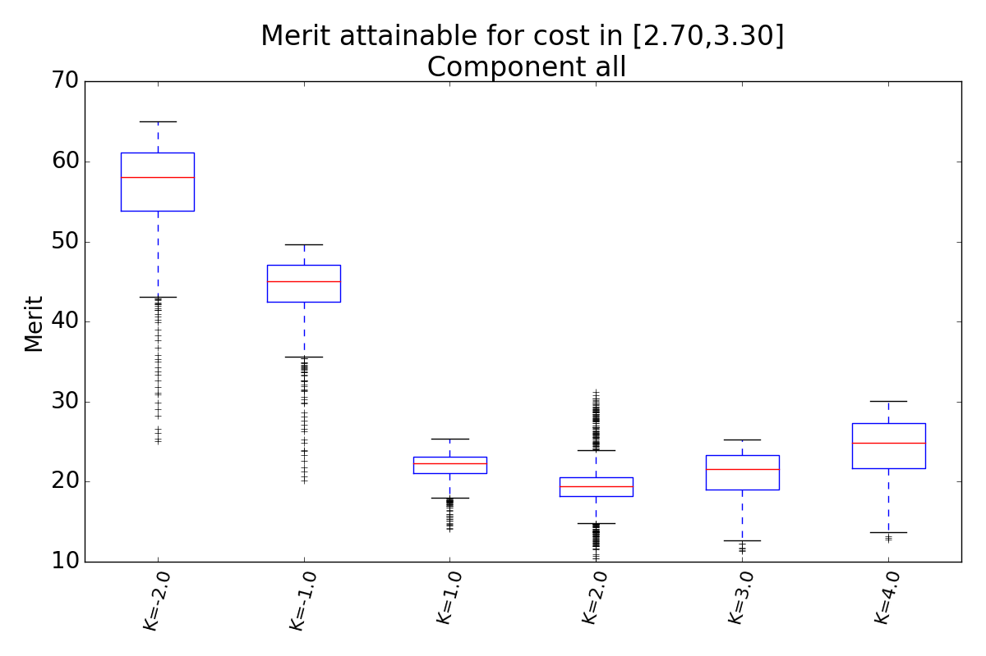
Boxplots show the distribution of merit I can obtain if I am willing to pay between 2.7 and 3.3 cost units

